Slide 1
Employee burnout prediction using linear regression

Slide 2

Student Details
Name: MATTAM JYOTHI SREE
Admission Number: AP22110011333
Email id: jyothisree_mattam@srmap.edu.in
Degree: B.tech
Year: II Year
Branch: Computer Science AND Engineering
College NAME : SRM AP University
College STATE : Andhra Pradesh
Summer Internship: Intern under Edunet Foundation through SRM University
Domain: AI&ML( Artificial intelligence and machine learning)(01-06-2024 to 25-07-2024)

Slide 3
PROJECT TITLE/Problem Statement
Project Title:
Employee Burnout Prediction Using Linear Regression
Project Statement:
Employees of the company are currently experiencing stress and depression as a result of their workload, deadline pressure, mental exhaustion, etc. As a result, they are unable to provide the organization with their entire promised workload, which also hinders the business's ability to develop.

Slide 4
AGENDA
Project Title: Employee Burnout Prediction using linear regression
Data Cleaning
Data Preprocessing
Correlation techniques to know which features are best for predicting target variable
One-hot encoding
Linear Regression
Performance metrics

Slide 5
PROJECT OVERVIEW
Purpose
The goal for this study is to create a prediction model that, when combined with a variety of work- and personal-related aspects, accurately predict employee burnout levels. The analysis aims to identify significant signs of burnout by using linear regression techniques. This will allow corporations to actively treat and prevent burnout, which will improve employee well-being, productivity, and turnover rates
Scope
Data from employee surveys and HR records will be collected for the project, with a focus on important aspects including work function, resource allocation, and mental exhaustion ratings. To manage missing values and ensure consistency, the data will be cleansed, preprocessed, and standardized. In order to guarantee correctness, a linear regression model will be created and assessed using metrics like Mean Absolute Error (MAE) and R-squared.

Slide 6

Objectives
The primary goals are to create a highly effective linear regression model for employee burnout prediction and include appropriate information sources. The study is to enable early detection of possible burnout cases and identify important factors of burnout, such as job role and mental exhaustion. This will support plans to improve overall employee well-being and productivity, enable quick and efficient measures, and offer practical suggestions for organizational improvements.

Slide 7

WHO ARE THE END USERS of this project?
Human Resources Professionals
Managers and Team Leaders
Employees
Data Analysts
Occupational Health Professionals

Slide 8
YOUR SOLUTION AND ITS VALUE PROPOSITION
Our approach to addressing the problem statement is to create a model that employs machine learning and linear regression techniques to predict employee burnout rate.
A variety of Python packages, such as NumPy, pandas, matplotlib, seaborn, and sci-kit-learn, were used in the development of our model. Multi-dimensional arrays can be created and operated on with NumPy. Pandas are used to work with data inside of data frames. Plotting data is done with Matplotlib, and data frame presentation is enhanced with Seaborn. For the creation of models and data preprocessing, Scikit-learn is necessary.

Slide 9
Value Proposition Points
Early Detection: Give timely interventions by predicting employee burnout.
Data-Driven Insights: Make exact observations about workers' well-being by utilizing cutting-edge machine learning methods.
Increased Productivity: Actively treat burnout to improve employee happiness and productivity.
Decreased Turnover: By managing burnout well, reduce the rate of employees turnover.

Slide 10
How did you customize the project and make it your own
To achieve my objectives, I modified a few components of this project. My main focus was on handling outliers, and I experimented with several scaling techniques to improve the performance of the linear regression model. I could see significant improvements in the model's performance by using both MinMaxScaler and StandardScaler. R-squared (R²) values, Mean Absolute Error (MAE), Root Mean Squared Error (RMSE), and Mean Squared Error (MSE) were among the metrics I examined. To gain further insight into the relationships between the variables, I also modified the correlation analysis. This involved incorporating and examining data outliers. This allowed me to assess the model's robustness and its response to anomalous data. The linear regression model was improved by these adjustments, which resulted in more accurate and trustworthy predictions.

Slide 11
MODELLING
First, we use pandas to generate a data frame after loading the dataset into the IDE. We handle null values and perform preprocessing and data cleaning. Using correlation analysis, we pick the best features for target variable prediction. Numerical values are derived from categorical values. The data is divided into training and testing sets in order to create the model. In order to predict the target variable, we finally use linear regression. Performance indicators like RMSE and MSE are then used to assess the model.

Slide 12
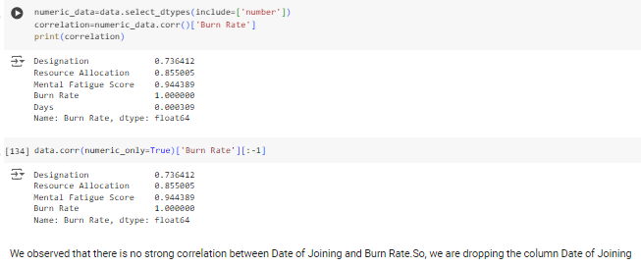
Results
choosing the data frame's best features based on correlation analysis in order to forecast the objective variable (Burn Rate).

Slide 13
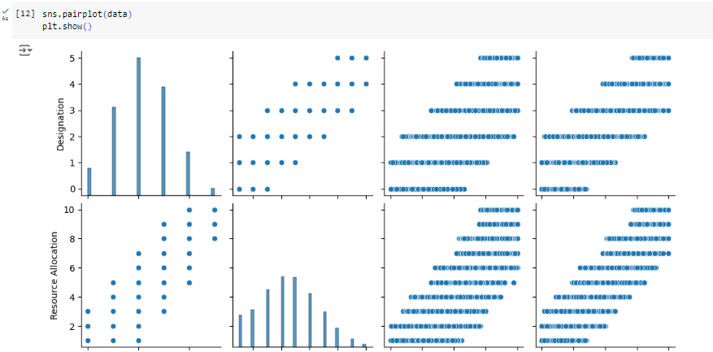
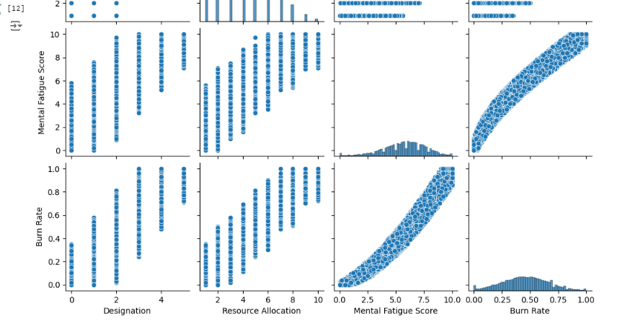

Slide 14
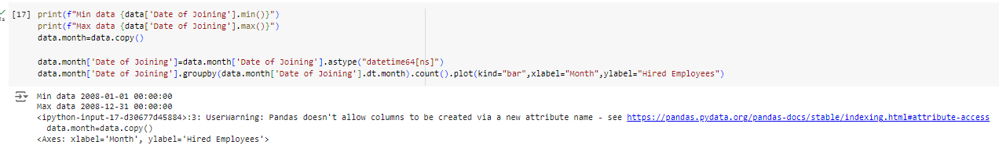
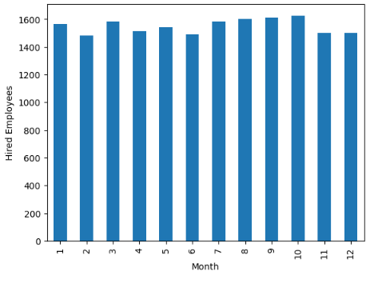
The number of new hires made each month is shown in the bar graph. The number of employees hired is displayed on the y-axis, while the x-axis depicts the months in the year. This graphic indicates the times when hiring activity is higher or lower and aids in identifying hiring trends over the course of several months.

Slide 15
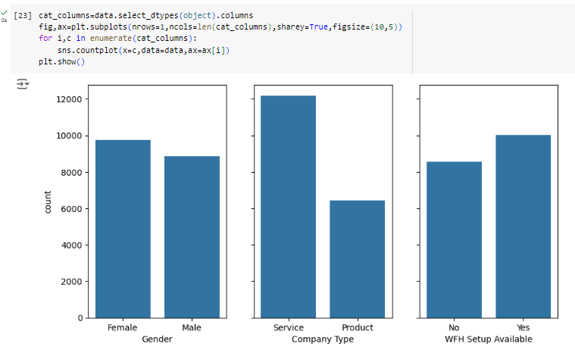
The distribution of the dataset's categorical variables is displayed in the count charts. Easy comparisons between variables are made possible by the distinct categorization columns that each subplot represents, each of which shows the frequency of a certain category.

Slide 16
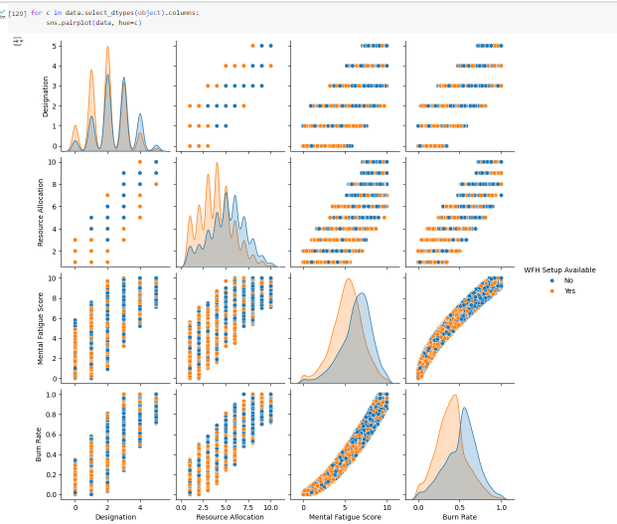
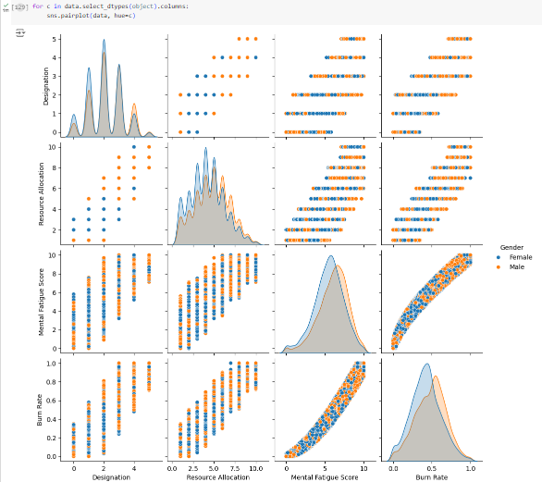

Slide 17
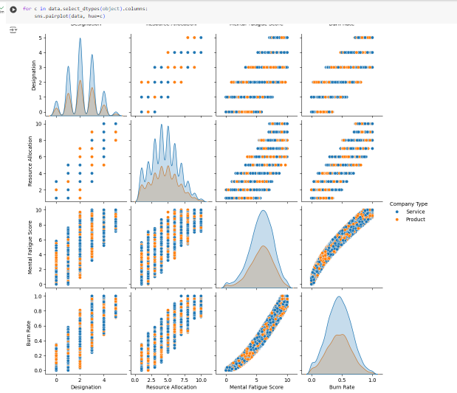
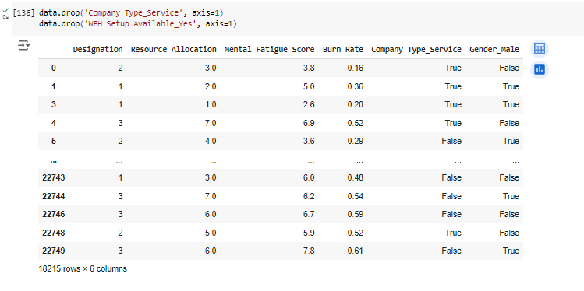

Slide 18

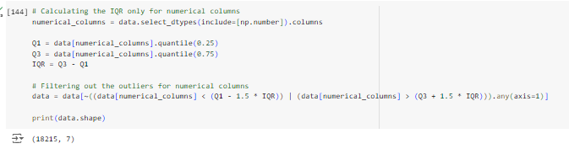
Initial Dataset
Final Dataset after outlier

Slide 19
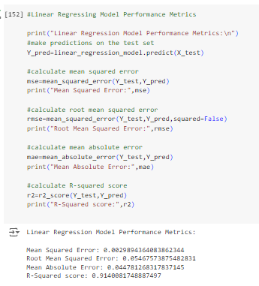
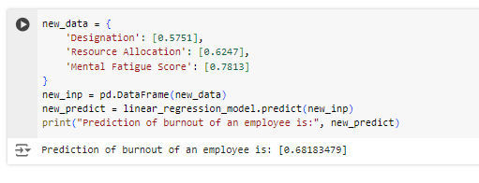
Linear regression model performance metrics:

Slide 20
Conclusion:
Using correlation analysis to determine which critical features to use, the linear regression model effectively predicts staff burnout rates. Performance measures demonstrate the model's dependability and productivity. This approach can provide businesses with important information that will enable them to take proactive steps to reduce or completely eliminate employee work burnout.

Slide 21
links
https://github.com/Mjyothi1/Employee-Burnout-Prediction
https://www.kaggle.com/datasets/blurredmachine/are-your-employees-burning-out?select=train.csv

